Slide 1


Slide 2

Technology & Innovation
Cybersecurity:
Safeguarding the
Digital Future
Technology,
Entrepreneurship &
Digital Transformation

Slide 3
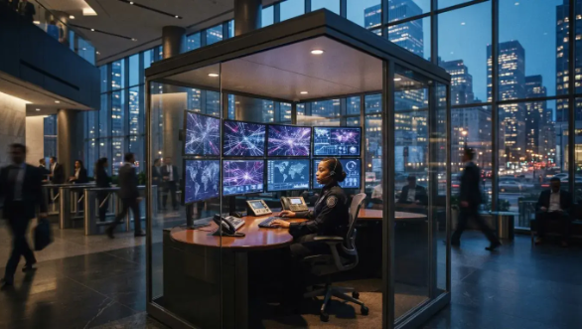
Why Cybersecurity
Matters Now
Rapid digitization has expanded both
attack surfaces and adversary
capabilities
What is
Why It Matters Now
Rapid Digitization
India's Digital
Cybersecurity?
Cyberattacks are among
Hyper-scale adoption
Growth
The practice of protecting
the fastest-growing global
across cloud computing,
Rapid adoption of UPI,
systems, networks, and
risks. A strong digital
IoT ecosystems, and AI has
Aadhaar, and digital public
data from digital attacks,
economy requires an
exponentially widened
infrastructure creates
damage, or unauthorized
equally resilient digital
organizational exposure.
high-value targets
access.
shield.
requiring proactive
sovereign security.

Slide 4
Threat Landscape Overview
Ransomware & Malware
Phishing & Social Engineering
Malicious payloads encrypting
Deceptive psychological tactics
operational systems and
designed to harvest credentials
demanding extortion payouts.
and bypass perimeter defenses.
IoT & Device Vulnerabilities
Data Breaches & Exfiltration
Proliferating connected hardware
Unauthorized intrusions exposing
with default or weak
proprietary databases and
authentication vectors.
confidential records.
AI-Generated Threats
Deepfakes, automated
reconnaissance probing, and self-
mutating polymorphic code.

Slide 5
Real-World
Cyberattacks
Impact
Malicious digital
intrusions
Across
Spheres
Evaluating downstream
repercussions across
individual, enterprise, and
national levels
Impacts include personal financial
fraud via targeted scams, regulatory
penalties and reputational erosion
for enterprises, and grid intrusions
Individual
Enterprise
National Impact
and systemic cyber warfare threats
Impact
Impact
Infrastructure
at the national level.
Privacy violations,
IP theft, capital loss
disruption, warfare
identity theft

Slide 6
Defensive Security Stack
Automated
Zero Trust
Intelligence
Continuous
1
2
Behavioral heuristics
authentication
mitigating zero-day
enforcing strict
anomalies.
verification.
Compliance
Boundary
Frameworks
3
4
Security
Regulatory mandates
Foundational transit and
and reporting protocols.
access protection.

Slide 7
Future Trends & Market Opportunities
Cybersecurity Talent & Venture
Growth: Escalating demand for
specialized security architects,
cyber insurance, and specialized
defense ventures.
AI-Powered
Quantum-
Cloud-Native
Defense
Resistant
Security
Crypto
Automated,
Decentralized
machine-speed
Long-term secrets
protection models
counter-measures
protected

Slide 8
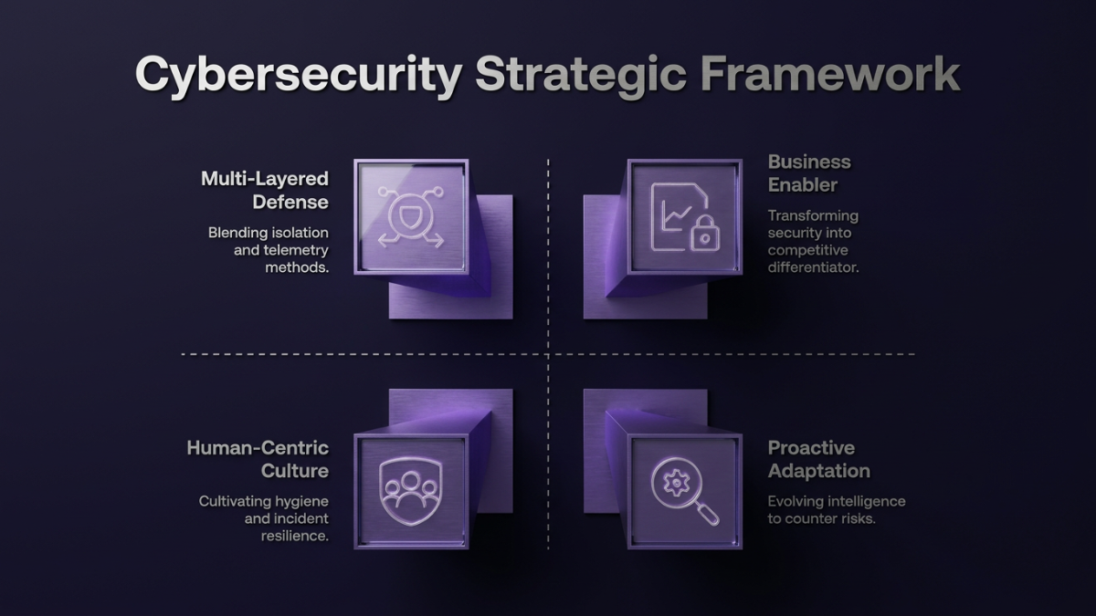

Slide 9

Next Steps
Open for
Questions &
Discussion
Engineering the Future ·
Thank You
ISHU RAJ — ROLL-261014
RAHUL N CHAUDHARY — ROLL-261018
RAUNIT KUMAR — ROLL-261036
HARSH RAJ — ROLL-261029
Thank You

